Slide 1

Intruder Detection System
Advanced Security Technology
Photo by Pexels

Slide 2
Table of Contents
01
Introducing Advanced Security
02
Real-time Surveillance and Alerts
03
Analytics and Detection Capabilities
04
Seamless Integration and Scalability
05
Remote Monitoring and Control
06
Comprehensive Security Solutions
07
Efficiency and Cost-effectiveness
08
User-friendly Interface and Accessibility
09
Scalable and Future-proof Security

Slide 3
10
Advanced Security Training and Support

Slide 4

1
Introducing Advanced Security
Secure Your Property
Advanced technology offers real-time surveillance and alerts to prevent unauthorized access and ensure maximum security for your premises.
Intrusion detection systems combine cutting-edge sensors and analytics to detect, track, and notify of any unauthorized entry or suspicious activity.
The system integrates seamlessly with existing security measures, providing a comprehensive shield against potential threats and enhancing overall safety within the premises.
Effortlessly monitor and manage security from anywhere, giving you peace of mind and control over the protection of your valuable assets.
Photo by Pexels

Slide 5

2
Real-time Surveillance and Alerts
Instant Security Updates
Continuous monitoring using high-resolution cameras ensures instant detection of any suspicious movements or intrusions within the restricted areas.
Receive immediate alerts through customizable notifications to your devices, enabling prompt response and action against potential security breaches.
The system records footage for future analysis and evidence, aiding in investigations and preventing recurrence of security incidents.
Stay informed and empowered with real-time updates on the status of your property, promoting proactive security practices and quick decision-making.
Photo by Pexels

Slide 6

3
Analytics and Detection Capabilities
Intelligent Threat Detection
Utilize advanced analytics and AI algorithms to analyze patterns, identify anomalies, and detect potential threats or unauthorized access attempts accurately.
Benefit from smart sensors that trigger alarms and emergency protocols based on predefined criteria, ensuring immediate responses to potential security breaches.
Leverage the power of machine learning to enhance the system's accuracy in differentiating between false alarms and genuine security threats, minimizing disruptions.
Empower your security team with actionable insights and data-driven decisions to strengthen security protocols and mitigate risks effectively.
Photo by Pexels

Slide 7

4
Seamless Integration and Scalability
Flexible Security Solutions
Easily integrate the intrusion detection system with your current security infrastructure, enabling a seamless operation that enhances the overall effectiveness and coverage of your security measures.
Scale the system to accommodate changes in your property's layout or security requirements, ensuring that the security solution evolves with your needs and remains adaptable to future expansions.
Achieve dynamic security management with centralized control and remote access features, allowing for efficient monitoring and administration of security across multiple locations.
Stay agile and responsive to evolving security challenges, ensuring that your security system remains robust, proactive, and capable of safeguarding your assets 24/7.
Photo by Pexels

Slide 8
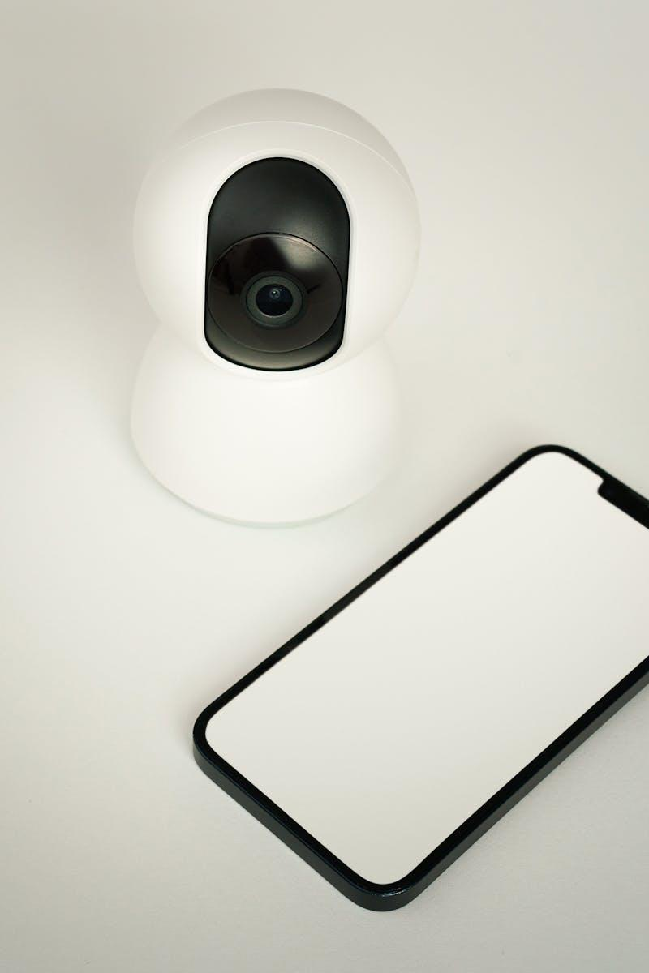
5
Remote Monitoring and Control
Anywhere, Anytime Security
Access the security system remotely from any device, enabling real-time monitoring of your property and security status from anywhere in the world.
Control access permissions, view live feeds, and receive instant alerts to respond promptly to security incidents, even when you are away from the premises.
Enable secure login credentials and encrypted communication channels to protect the integrity of the data transmission and ensure the confidentiality of your security information.
Empower yourself with the ability to oversee and manage security operations remotely, offering a proactive approach to security management and quick incident resolution.
Photo by Pexels

Slide 9

6
Comprehensive Security Solutions
Complete Protection Package
Combine intrusion detection systems with access control, CCTV surveillance, and alarm systems to create a comprehensive security solution that addresses all aspects of security threats.
Implement multi-layered security measures that work in synergy to provide a robust defense against potential intruders, unauthorized access, and security breaches of any kind.
Enhance the security ecosystem with automated responses, emergency protocols, and integrated communication systems that ensure a coordinated and effective defense strategy.
Invest in a holistic security approach that prioritizes prevention, early detection, and rapid response to security incidents, safeguarding your property and personnel effectively.
Photo by Pexels

Slide 10

7
Efficiency and Cost-effectiveness
Optimized Security Operations
Improve operational efficiency by automating security processes, reducing manual interventions, and streamlining security protocols for better resource allocation and utilization.
Minimize false alarms, human errors, and response delays through intelligent automation, ensuring that security incidents are handled swiftly and accurately, minimizing downtime and risks.
Optimize resource allocation by deploying smart technologies that actively adapt to changing security needs, ensuring cost-effective solutions without compromising on security standards.
Achieve a balance between security effectiveness and operational costs, maximizing the value of your security investments and enhancing the overall security posture of your property.
Photo by Pexels

Slide 11

8
User-friendly Interface and Accessibility
Intuitive Security Management
Experience a user-friendly interface that simplifies security management, enabling easy navigation, quick access to essential features, and intuitive controls for enhanced user experience.
Empower users with training and support to utilize the system effectively, ensuring optimal usage, quick troubleshooting, and seamless integration into daily security operations.
Promote user adoption and engagement through interactive interfaces, informative dashboards, and customizable settings that cater to the specific needs and preferences of different users.
Foster a culture of security awareness and responsibility among users, encouraging proactive participation in security measures and promoting a safe and secure environment for all.
Photo by Pexels

Slide 12
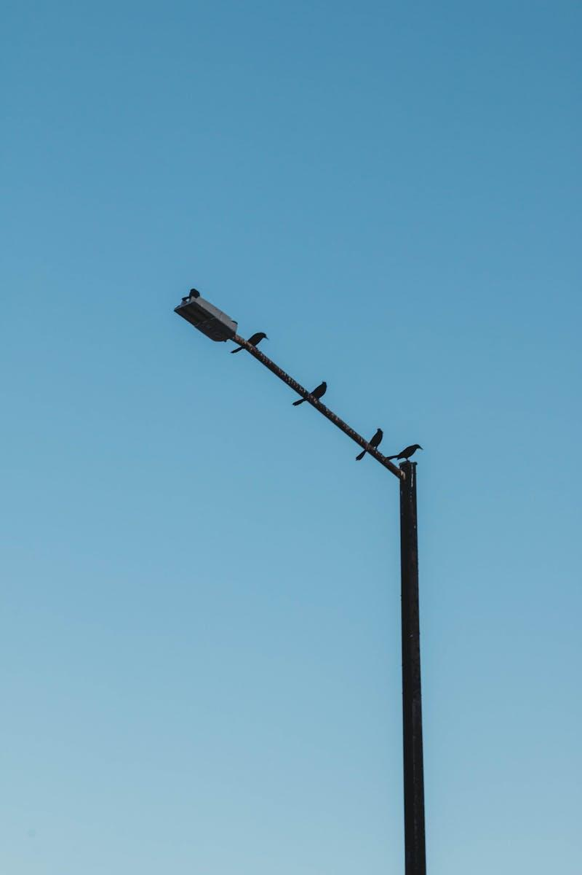
9
Scalable and Future-proof Security
Adaptable Security Solutions
Future-proof your security infrastructure by choosing scalable solutions that can accommodate growth, technological advancements, and evolving security threats without requiring significant overhauls.
Implement modular and upgradable components that allow seamless integration of new features, technologies, and security enhancements as needed, ensuring continuous protection and innovation.
Stay ahead of emerging security risks and challenges by investing in flexible solutions that can adapt to changing needs, regulatory requirements, and industry standards effortlessly.
Protect your investment by choosing security solutions that offer longevity, flexibility, and compatibility with emerging technologies, securing your property's security for years to come.
Photo by Pexels

Slide 13

10
Advanced Security Training and Support
Empowering Users
Provide comprehensive training programs and access to technical support to equip users with the knowledge and skills required to effectively utilize and manage the intrusion detection system.
Empower users with best practices, troubleshooting guides, and security protocols to enhance their understanding of security operations and promote a culture of security consciousness.
Offer continuous learning opportunities, updates on system enhancements, and efficient support channels to ensure users remain proficient in utilizing the security system optimally.
Invest in user empowerment to create a knowledgeable, vigilant, and proactive security community that actively contributes to maintaining a secure environment for all stakeholders.
Photo by Pexels

